Slide 1
Introducing Mikrotik RouterBoard and RouterOS
Mike Everest
DuxTel Pty Ltd
www.duxtel.com

Slide 2
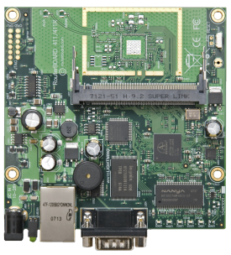
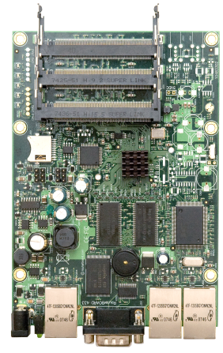
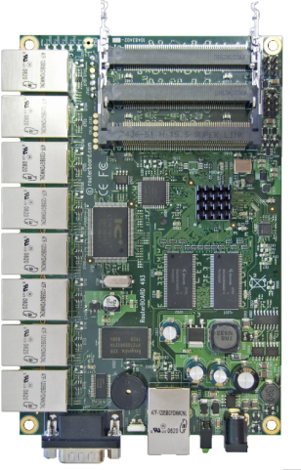
BASE MODELS
Entry Level RouterBoard systems:
Based on Atheros 300MHz CPU
64M RAM
1 or more 10/100 auto MDI-MDIX ethernet
Most models also support 1 or more mini-pci expansion for wireless interfaces
Power jack for 9v – 38v input
Ethernet1 port PoE capable
RS232 serial port
Examples (pictured):
RB/411 – 1 ethernet, 1 mini-pci
RB/433 – 3 ethernet, 3 mini-pci
RB/493 – 9 ethernet, 3 mini-pci

Slide 3
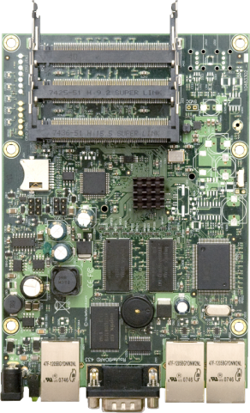
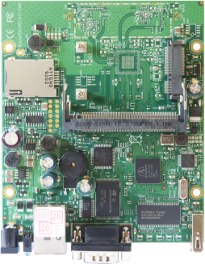
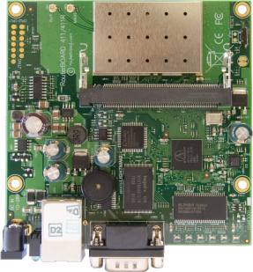
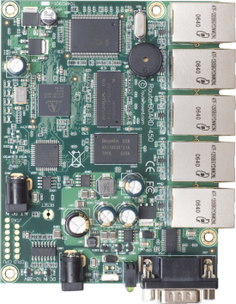
ENHANCED MODELS
Enhanced features include:
Faster CPU (e.g. 411AH – 680MHz)
Extra RAM (e.g. 493AH – 128M RAM)
On-board 802.11b/g wireless (e.g. 411R)
Gigabit ethernet (e.g. RB/450G)
USB ports (e.g. RB/433UAH – 2 USB)
SD-RAM Slot (e.g. RB/433AH)
3G SIM slot (e.g. RB/411U)

Slide 4
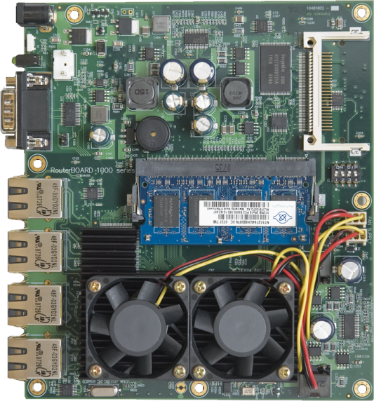
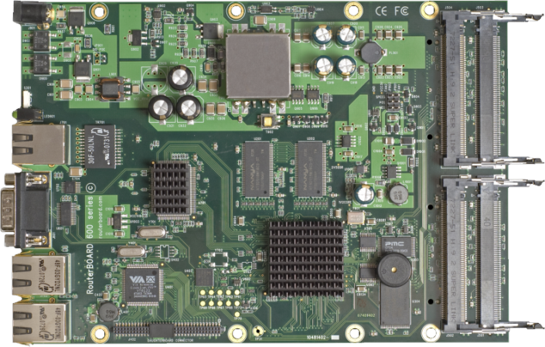
PERFORMANCE MODELS
PowerPC based router systems:
RB1000
1300MHz CPU
512MB RAM SODIMM
2x CF expansion
3x gigabit Ethernet
RB600A
266MHz CPU
128MB RAM
4x mini-pci slot expansion
3x gigabit Ethernet

Slide 5
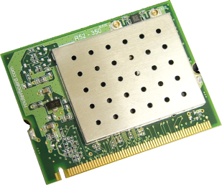
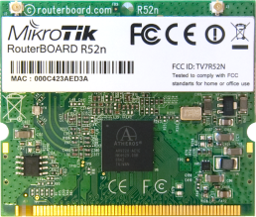
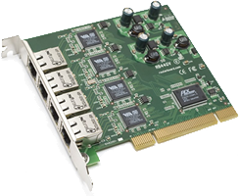
PERFORMANCE MODELS
Specially designed RouterBoard expansion slots include 802.11a/b/g and 802.11a/b/g/n wireless mini-pci adapters
R52H
802.11a/b/g
350mW transmit output
5GHz band (includes 5.1 and 5.4 spectrum)
2.4GHz band – full 13 channels
R52N
Also supports 802.11n standard
IN/G44V
4x gigabit ethernet ports
Full form factor PCI interface for PC based router systems

Slide 6
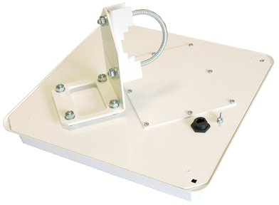
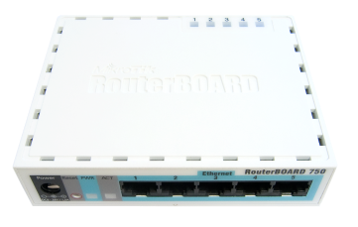
PACKAGED KITS
Packaged, ready-to-deploy systems available include:
RB1000U – RB/1000 in rack-mountable case with internal power supply
RIC/522 RB/411 based point to point bridge system in integrated 5GHz antenna
RB/750 SOHO Router

Slide 7
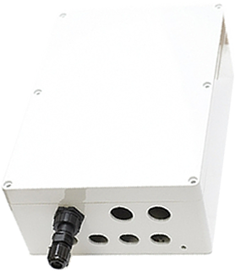
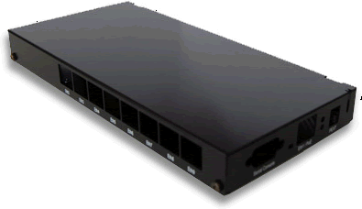
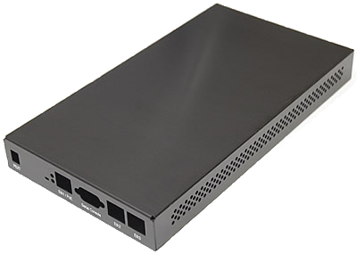
INDOOR AND OUTDOOR CASES
A full range of indoor and outdoor cases are available suitable for all RouterBoard models

Slide 8
SELECTION GUIDE

Slide 9
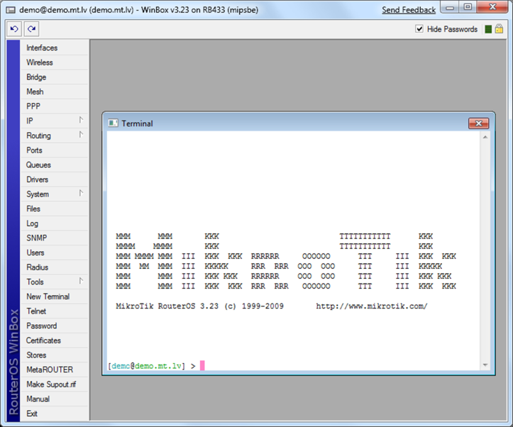
RouterOS
RouterOS is a stand-alone operating system based on the Linux v2.6 kernel, and our goal here at MikroTik is to provide all these features with a quick and simple installation and an easy to use interface.

Slide 10
RouterOS
RouterOS is a stand-alone operating system based on the Linux v2.6 kernel, and our goal here at MikroTik is to provide all these features with a quick and simple installation and an easy to use interface.
Wireless and Wired interfaces (ethernet)
Stateful Firewall with NAT and powerful Packet matching and inspection
Layer 2 configuration – bridging and VLANs
Layer 3 IP4 and IP6
Advanced QoS and traffic management
Built-in applications including web proxy captive portal (HotSpot)
Full featured set of administrative tools including packet sniffing and bandwidth testing

Slide 11
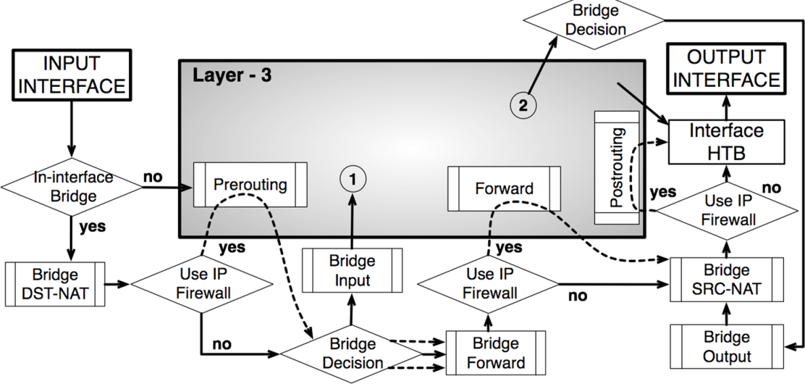
FIREWALL
RouterOS features a stateful firewall with internal packet, connection, and route marking based on more than 50 independent properties.
It can filter by IP address, address range, port, port range, IP protocol, DSCP and other parameters, also supports Static and Dynamic Address Lists, and can even match packets by pattern in their content, specified in Regular Expressions, called Layer7 matching.
The RouterOS Firewall facility also supports IPv4 and IP6 packets.

Slide 12
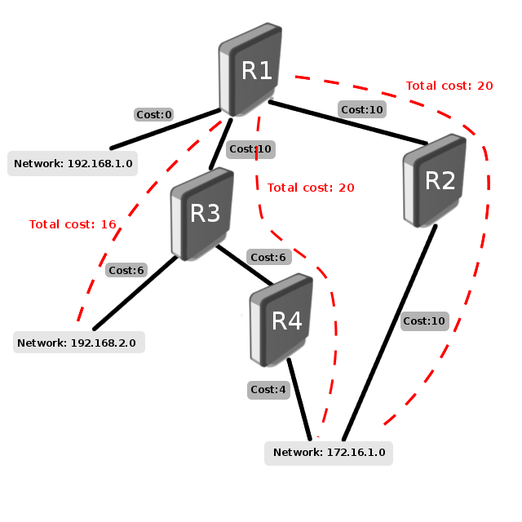
ROUTING
RouterOS supports static routing and a multitude of dynamic routing protocols.
For IPv4 it supports:
RIP v1 and v2
OSPF v2
BGP v4.
For IPv6 it supports:
RIPng
OSPFv3
BGP
RouterOS also suppors Virtual Routing and Forwarding (VRF), Policy based routing, Interface based routing and ECMP routing.
You can use the Firewall filter to mark specific connections with Routing marks, and then make the marked traffic use a different ISP.

Slide 13
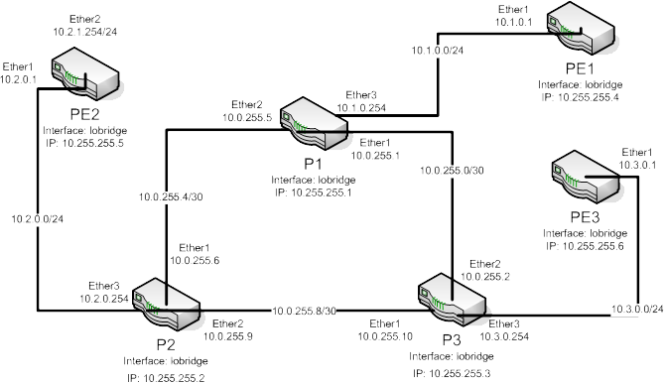
MPLS
MultiProtocol Label Switching. It can be used to replace IP routing - packet forwarding decision is no longer based on fields in IP header and routing table, but on labels that are attached to packet. This approach speeds up forwarding process because next hop lookup becomes very simple compared to routing lookup.

Slide 14
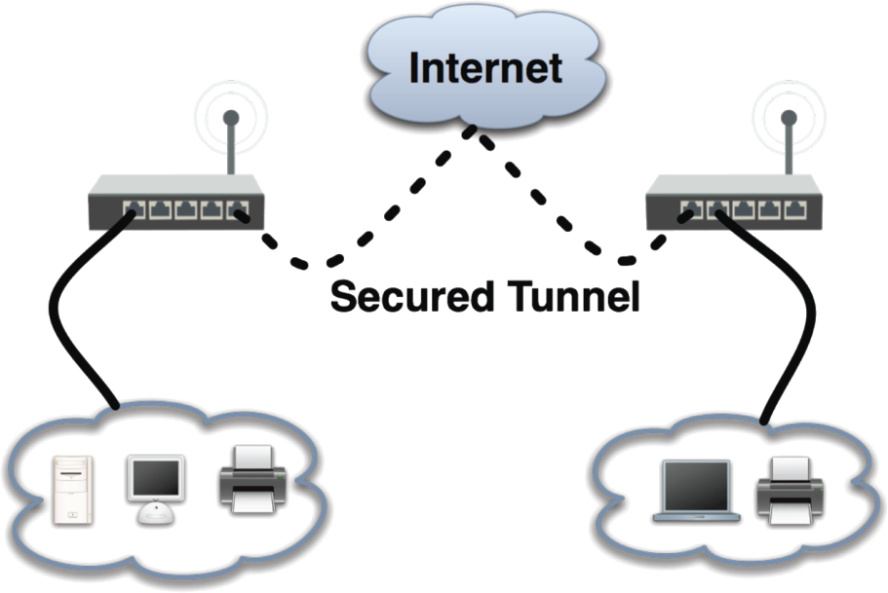
VPN
RouterOS supports various VPN methods and tunnel protocols:
• Ipsec – tunnel and transport mode, certificate or PSK, AH and ESP security protocols
• Point to point tunneling (OpenVPN, PPTP, PPPoE, L2TP)
• Advanced PPP features (MLPPP, BCP)
• Simple tunnels (IPIP, EoIP)
• 6to4 tunnel support (IPv6 over IPv4 network)
• VLAN – IEEE802.1q Virtual LAN support, Q-in-Q support
• MPLS based VPNs

Slide 15
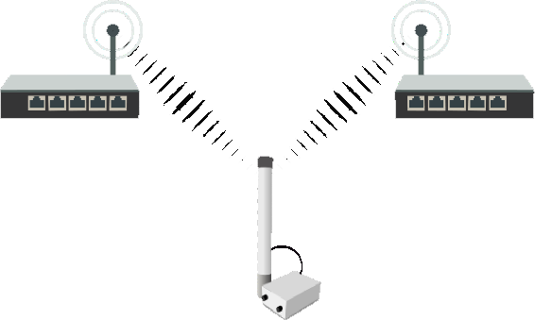
WIRELESS – Point to Multipoint
A variety of Wireless technologies are suppored in RouterOS, the most basic of them being the wireless access point and client. Some of the features supported by RouterOS:
• IEEE802.11a/b/g/n wireless client and access point
• Nstreme and Nstreme2 proprietary protocols
• Client polling
• RTS/CTS
• Wireless Distribution System (WDS)
• Virtual AP
• WEP, WPA, WPA2 encryption
• Access control list
• Wireless client roaming
• WMM
• HWMP+ Wireless MESH protocol
• MME wireless routing protocol

Slide 16
WIRELESS – Point to Point
RouterOS also features the NStreme proprietary wireless protocol that allows to extend the connection range and speed, when using MikroTik routers at each end. This has helped to achieve the current non-amplified wifi link length world record in Italy (304Km). Also supported is NSteme dual which allows to use two antennas at each end, one for receiving and one for sending.

Slide 17
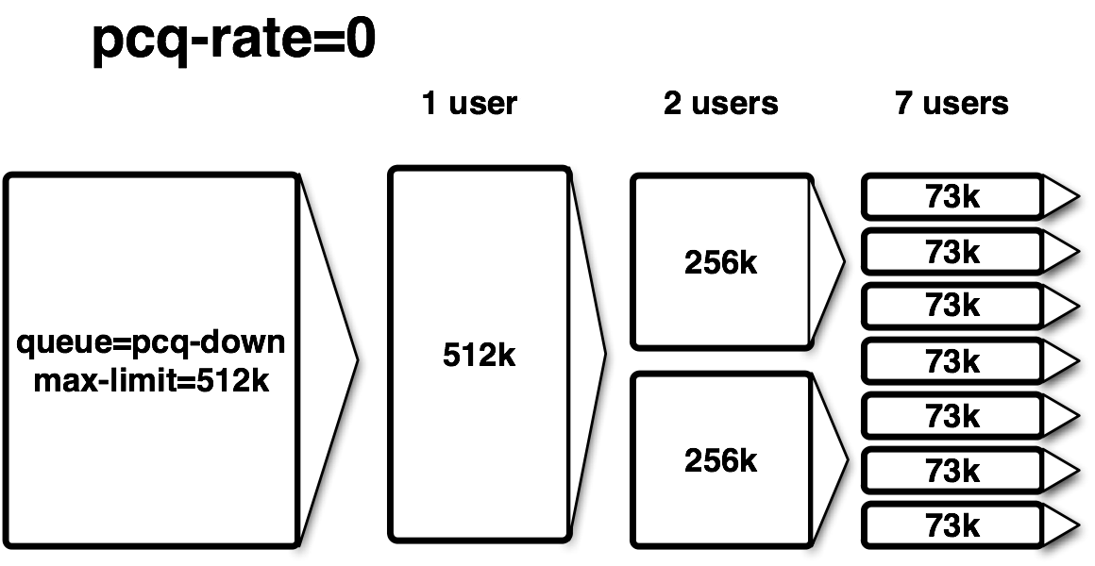
QoS
Bandwidth Control is a set of mechanisms that control data rate allocation, delay variability, timely delivery, and delivery reliability.
Quality of Service (QoS) means that the router can prioritize and shape network traffic. Some features of MikroTik RouterOS traffic control mechanism are listed below:
• limit data rate for certain IP adresses, subnets, protocols, ports, and other parameters
• limit peer-to-peer traffic
• prioritize some packet flows over others
• use queue bursts for faster web browsing
• apply queues on fixed time intervals
• share available traffic among users equally, or depending on the load of the channel

Slide 18
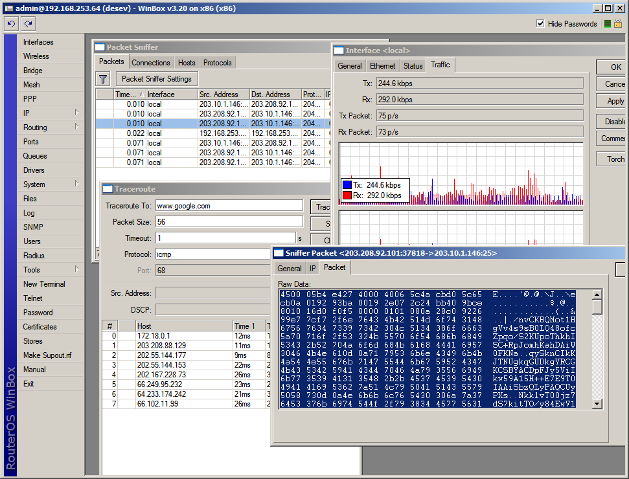
TOOLS
To help administrating your network, RouterOS also provides a large number of small network tools to optimize your everyday tasks. Here are some of them:
• Ping, traceroute
• Bandwidth test, ping flood
• Packet sniffer, torch
• Telnet, SSH
• E-mail and SMS send tools
• Automated script execution tools
• CALEA data mirroring
• File Fetch tool
• Active connection table
• NTP Client and Server
• TFTP server
• Dynamic DNS updater
• VRRP redundancy support
• SNMP for providing graphs and stats
• RADIUS client and server (User Manager)

Slide 19
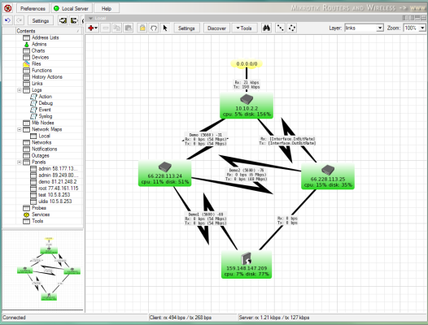
APPLICATIONS
HOTSPOT
Built-in walled garden provides a powerful captive portal public access hotspot system with MAC address authentication capabilities and RADIUS server
Web Proxy
Fully featured web cache supporting transparent and traditional web proxy plus SOCKS. Web cache can be stored on-board for high performance, or external storage for high capacity
The DUDE Network Management
The Dude SNMP network monitor is a free application by MikroTik which can dramatically improve the way you manage your network environment. Provides real-time availability and performance logging and graphing of any SNMP device

Slide 20
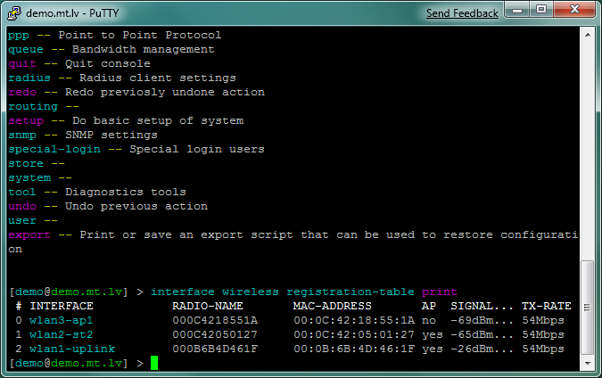
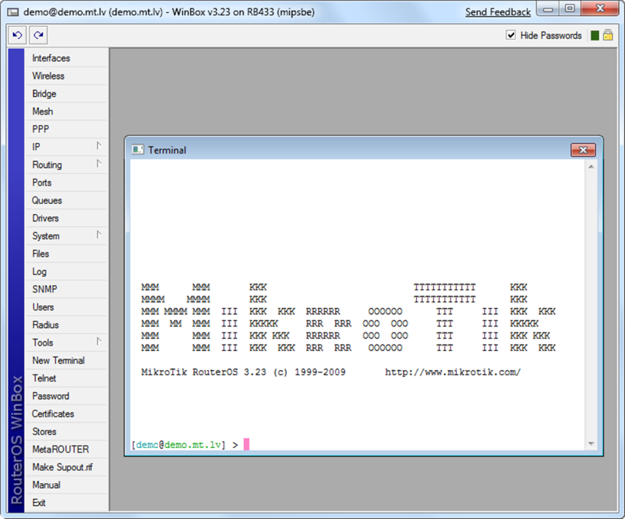
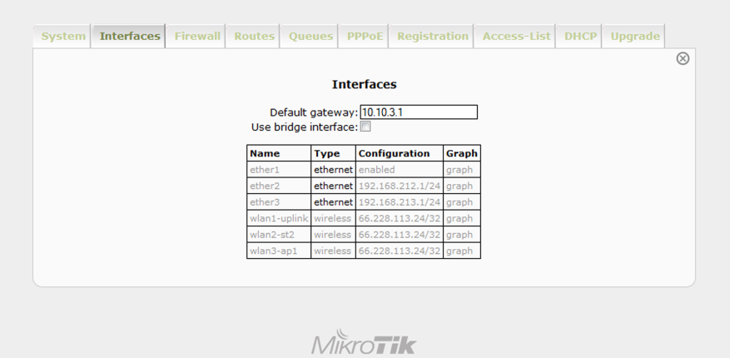
CONFIGURATION
Configuration is by three methods:
Shell access by telnet, ssh or serial port
Rudimentary web based interface
Winbox – the most powerful GUI configuration tool on the planet!

Slide 21
Winbox Demo

Slide 22
More information:
Official Mikrotik Web Site: http://www.mikrotik.com
Full product information
Full Documentation
User Forums
Wiki Documents
Official RouterBoard Web Site: http://www.routerboard.com
Product Catalogue and Documentation
Australian Distributor:
DuxTel Pty Ltd http://www.duxtel.com.au
Buy online @ http://shop.duxtel.com.au
also configuration guides and articles
Learn RouterOS
– the definitive Guide by Dennis Burgess

Slide 23
DuxTel Pty Ltd:
Working with Mikrotik systems for 6+ years
Authorised Australian Distributor for Mikrotik ROuterOS and RouterBoard
Authorised Australian Mikrotik Consultant
Stocking most RouterBoard systems, antennas, cases, power supplies
Mike Everest (BSc, DipEd, GDipComp):
18+ years experience in IT systems and data network technologies
Certified Mikrotik Consultant, and leading expert in Australia for Mikrotik products and solutions
Available for consulting and advice for ISP and Data Communications industry

